Slide 1
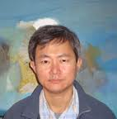
Reservist
By Boey Kim Cheng
The Singapore Armed Forces is the military arm of the Total Defence of the Republic of Singapore. The SAF comprises three branches: the army, air force and navy). The SAF protects the interests, sovereignty and territorial integrity of Singapore from external threats.
The SAF relies heavily on a large pool of conscripts in the active and reserve forces. It has an active strength of around 71,600 personnel and is capable of mobilising over 350,000 reservists

Slide 2
GET FLIRTY!!!
Focus on the form of the poem , looking at the structure, punctuation, line lengths and the arrangement of the poem’s stanzas. How do these features add interest and meaning to the poem? Also examine the arrangements of the words, phrases and sentences in the poem.
Examine the language used in the poem, looking at the meaning of words and whether they have negative or positive connotations.
Look at the techniques, imagery and poetic language that has been used? How do these techniques bring out the main themes and ideas in the poem?
How does the poet make use of rhyme, repetition and rhythm? Why does he do this?
What are the poet’s main ideas that he brings out in the poem and how does he do this? Explain the feelings that the poet conveys throughout the poem. Describe the poet’s attitude to his subject. Does this change as the poem progresses? Carefully examine the tone throughout the poem and find vocabulary to back up your discussion.
How do you react to this poem? Does it bring any particular thoughts to mind? Which poems would you compare this one with?
F
L
I
R
T
Y

Slide 3
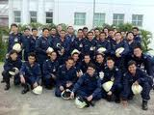
BACKGROUND
Boey Kim Cheng (born 1965) is a Singapore-born Australian poet.
He is of Chinese descent. As a student he won the National University of Singapore Poetry Competition and has since received the National Arts Council's Young Artist Award (1996). He currently lectures in Creative Writing at the University of Newcastle in New South Wales.

Slide 4
BOEY KIM CHENG’S EARLY LIFE
Boey Kim Cheng was born in Singapore in 1965. He received his secondary education at Victoria School and graduated with Bachelor of Arts and Masters of Arts degrees in English Literature from the National University of Singapore. In 1993, he won a scholarship from the Goethe-Institut to pursue German Studies in Murnau. In the following year, he was sponsored by the United State Information Agency to attend the International Writing Program at the University of Iowa. Boey embarked on a doctoral programme with the National University of Singapore which he later discontinued. He entered the workforce and was employed by the Ministry of Community Development as a probation officer. Disillusioned with the state of literary and cultural politics in Singapore, Boey left for Sydney with his wife in 1997. While in Australia, Boey completed his Ph.D. studies with the University of Macquarie. Boey is currently an Australian citizen and teaches creative writing at the University of Newcastle.

Slide 5
BOEY KIM CHENG’S LITERARY CAREER
At age 24, he published his first collection of poetry. Somewhere-bound went on to win the National Book Development Councils (NBDCS) Book Award for Poetry in 1992. Two years later, his second volume of poems Another Place received the commendation award at the NBDCS Book Awards. In 1995, Days Of No Name, which was inspired by the people whom he met in the United States, was awarded a merit at the Singapore Literature Prize. In recognition of his artistic talent and contributions, Boey received the National Arts Council's Young Artist Award in 1996. After a long hiatus, Boey returned with his fourth volume of poetry in 2006. After the Fire deals primarily with the passing of his father in 2000. Boey's works have also appeared in anthologies like From Boys to Men: A Literary Anthology of National Service in Singapore, Rhythms: A Singaporean Millennial Anthology of Poetry and No Other City: The Ethos Anthology of Urban Poetry.
Boey's works are highly regarded by both the academic and writing communities in Singapore. Writer Shirley Lim remarked that he is the "best post-1965 English language poet in the Republic today". His own sense of restlessness about life in Singapore is reflected prevalently in his poems. According to him, Singapore's rapid growth and swift economic success are achieved at a cost. Feelings of displacement and disconnection with the past occurred precisely because places where one experienced his or her sense of belonging, through their childhood are fast disappearing.

Slide 6
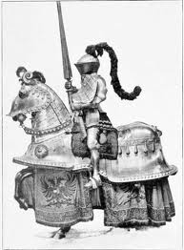
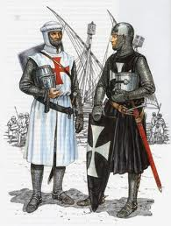
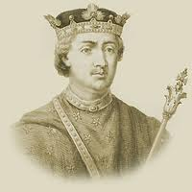
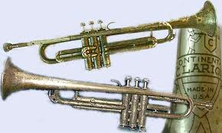
RESERVIST STANZA ONE
Time again for the annual joust, the regular fanfare,
a call to arms, the imperative letters stern
as clarion notes, the king’s command, upon
the pain of court-martial, to tilt
at the old windmills. With creaking bones
and suppressed grunts, we battle-weary knights
creep to attention, ransack the wardrobes
for our rusty armour, tuck the pot bellies
with great finesse into the shrinking gear
and with helmets shutting off half our world,
report for service. We are again united
with sleek weapons we were betrothed to
in our active cavalier days.

Slide 7
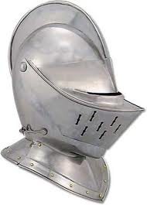
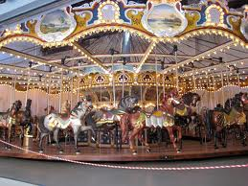
RESERVIST STANZA TWO
We will keep charging up the same hills, plod
through the same forests, till we are too old,
too ill-fitted for life’s other territories.
The same trails will find us time and again,
and we quick to obey, like children placed
on carousels they cannot get off from, borne
along through somebody’s expensive fantasyland,
with an oncoming rush of tedious rituals, masked threats
and monsters armed with the same roar.

Slide 8
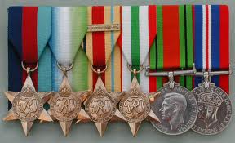
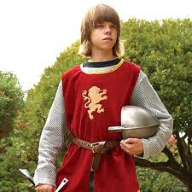
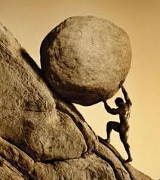
STANZA THREE
In the end we will perhaps surprise ourselves
and emerge unlikely heroes with long years
of braving the same horrors
pinned on our tunic fronts.
We will have proven that Sisyphus is not a myth.
We will play the game till the monotony
sends his lordship to sleep.
We will march the same paths till they break
onto new trails, our lives stumbling
onto the open sea, into the daybreak.

Slide 9
Vocabulary in the poem
RESERVIST- every man in Singapore up to the age of 40 has to train a certain numbers of days per year with the army to refresh his army training. It is compulsory for all Singaporean men to spend two years in the army after school or university. What other countries have this requirement?
Clarion –a war trumpet
Tilt – charge on horse back, joust with –Cervantes's Don Quixote attacked windmills, thinking them enemy knights
Cavalier –knightly, youthful
Carousels- merry-go-rounds
Sisyphus-was a king punished by being compelled to roll an immense boulder up a hill, only to watch it roll back down, and to repeat this throughout eternity. He is also found in Roman mythology.
The word "Sisyphean" means "endless and unavailing, as labour or a task.”
Sisyphus was son of King Aeolus of Thessaly and Enarete, and the founder and first king of Ephyra (Corinth).

Slide 10
VOCABULARY Look up the following words and phrases in the poem to gain a clearer understanding:
-joust
-court-martial
-ransack
-finesse
-betrothed
-tedious rituals
-finesse
-betrothed
-tedious rituals
-fanfare
-call to arms
-imperative
-court-martial
-ransack
-finesse
-betrothed
-tedious rituals

Slide 11
Vocabulary
Look at the type of vocabulary that Boey has used in the poem both positively and negatively. What connotations is he bringing out and look at the effects he is hoping to achieve?
Have any allusions been used in the poem? Explain these in depth.

Slide 12
MILITARY JARGON and STRUCTURE
The whole poem is full of military jargon.
- Give at least six examples of military jargon in the poem.
How does the poet make the poem sound very cynical? What is the effect of this?
STRUCTURE
Describe the structure of the poem?
How many lines in each stanza?
Look at the pattern of line lengths in each stanza. Why do you think Boey has done this and explain the effect?
Why do you think that Boey has done this?

Slide 13
Summary of the main ideas in Stanza One
Stanza one
The men of the poet’s reserve troop have been summoned to their annual training session so that all the men of a certain age in Singapore are ready to defend their country. The letters summoning the men arrive and they are not allowed to miss the training. The men are out of shape and possibly unfit. They pay attention to the call-up to practise and have to find their old uniforms and gear that has been tucked away in their wardrobes. The uniforms are too small as they have put on weight so they shove themselves carefully into these tight uniforms. The helmets are also
large and they cannot see clearly from them –maybe this is due to the soldiers becoming bald and their helmets are now too loose. The men report for training and are confronted again with the very modern and sleek weapons of their youthful army years, many years ago.
This stanza is about getting ready for the training period. The politicians of Singapore began military training as a way to discipline and control the young men of their country as well as defend the city state of Singapore.

Slide 14
Summary of Stanza Two
STANZA TWO:-
This stanza is about the men at the training event. They are on the move all the time –going up familiar hills, the same forests. They will repeat the exercises yearly until they are too old (around 40 or so) and then not suited to this type of activity due to their physical limitations.
The same trails will be repeatedly used to train them and like young children they will do what they are told quickly. This obeying is compared to young children being placed on carnival carousels which they are not allowed to get off and experience the excitement and fantasy that someone else has built for them. The men are like the children- they must obey or they will be fined or imprisoned or not doing what they are told because the ex Singaporean Prime Minister Lee Kwan Yue thought up this regular training so all the men could defend their country if it was attacked.
Boey Kim Cheng likens the military traditions and customs as boring and never changing, war-games and fighting make-believe enemies childish and made-up.
Again the poet ridicules these activities and sounds quite cynical.

Slide 15
SUMMARY OF STANZA THREE
STANZA THREE:-
The stanza begins with the poet suggesting the men might surprise themselves and act like unlikely heroes at having braved the many years that they were called to annual training and they got rewarded with braids and medals pinned to their tunics for their years of service in the Singapore Reserve Army. Instead of being cynical, Boey Kim Cheng sounds quite pleased in a way as it shows the determination and the challenges these men had to face – it is also a way to keep the males of the country fit and in good health.
By referring to Sisyphus,a mythical king who was being punished for son reason by having to endlessly roll boulders up hills and then watch them roll back down, Boey states that by doing the same thing repeatedly and endlessly every year they survived the torture and hard slog. He say the men are also determined not to be out done and they will continue following orders until Sisyphus goes to sleep with the boredom makes the king drop off to sleep.
In the last three lines he states the men will continue following the same annual training until they are too old for it and then they will become involved with new idea and interests befitting their age and physical abilities. The words “our lives stumbling onto the open sea, into daybreak” describes them exploring other avenues, waking up and exploring other worlds to that of the Singapore Reserve Army. At times Boey seems to suggest that the army consumes these men and restricts – they are unable to really do what they want to because they owe allegiance and loyalty to their country and political laws also bind them to this with the threat of imprisonment.

Slide 16
Poet’s purpose and style
What do you think is the poet’s purpose for writing this poem? Boey Kim Cheng’s main intentions were to inform the readers about…
The poem has no constant rhyme scheme where as many of Boey’s other poems do.
Why do you think he did not include a constant rhyme scheme in this poem?
The poem is written in free verse and also in a narrative style. Why do you think he structured the ideas in each stanza differently? What is the intended effect of doing this?
Another feature of Boey’s style is including references to classical mythological characters. Explain why he has used Sisyphus and his tale in the third stanza. What comparison is he trying to make between the soldiers and the king? Is it effective?

Slide 17
Tone and moods evident in the poem
What tone of voice does the poet use in the poem? Does it change ?
Explain the moods and feelings evident in the poem. How are these brought out and explain the effects of each mood and feeling? Do they add interest to the poem? Explain in depth.
How do the tone, moods and feelings of the poem highlight the themes and main ideas ?

Slide 18
Language devices and punctuation in the poem
Go through each stanza and pick out the language devices, describe how they have been used and their effects. Pay particular attention to figurative devices and sound devices.
Look at the imagery used in the poem – classify it under the following types of imagery –Visual imagery - something seen in the mind's eye
Auditory imagery - represents a sound
Olfactory imagery - a smell
Gustatory imagery - a taste
Tactile imagery - touch, for example hardness, softness, wetness, heat,
cold
Organic imagery - internal sensation: hunger, thirst, fatigue, fear
Kinesthetic imagery - movement or tension
Explain the imagery you have found and explain the effect of each image.
How does this image add meaning to the poem and themes.
3. What symbols and symbolism is evident in the poem? Explain the effect of the use of symbols and state how they add meaning to the poem.

Slide 19
Language devices, punctuation and themes in the poem
Look at the way punctuation features have been used in the poem and explain the effects of these. Pay attention to the use of caesuras (commas in the middleof the line and full stops), end stopped lines and enjambment.
THEMES IN RESERVIST
Re-read the poem and discuss with your partner or group the main ideas and themes in the poem.
How are these themes brought out in the three stanzas?
What do you think Boey really shows about the idea of being a reservist? Write a full two paragraphs on this.

Slide 20
COMPARE WITH…
Compare the poem with the following poems:-
Cambodia
Attack
http://www.youtube.com/watch?v=W9x6TXND9es

