Slide 1
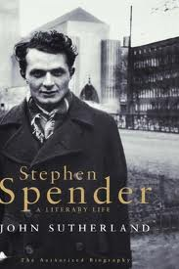
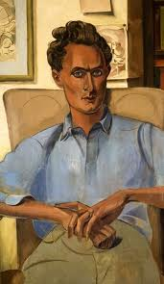
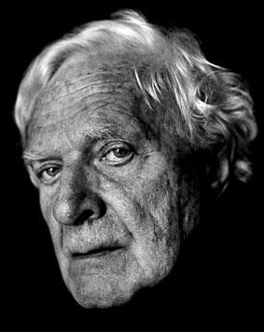
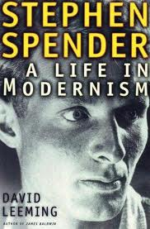
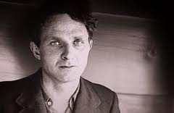
My Parents

Slide 2
GET FLIRTY!!!
F
L
I
R
T
Y
Focus on the form of the poem , looking at the structure, punctuation, line lengths and the arrangement of the poem’s stanzas. How do these features add interest and meaning to the poem? Also examine the arrangements of the words, phrases and sentences in the poem.
Examine the language used in the poem, looking at the meaning of words and whether they have negative or positive connotations.
Look at the techniques, imagery and poetic language that has been used? How do these techniques bring out the main themes and ideas in the poem?
How does the poet make use of rhyme, repetition and rhythm? Why does he do this?
What are the poet’s main ideas that he brings out in the poem and how does he do this? Explain the feelings that the poet conveys throughout the poem. Describe the poet’s attitude to his subject. Does this change as the poem progresses? Carefully examine the tone throughout the poem and find vocabulary to back up your discussion.
How do you react to this poem? Does it bring any particular thoughts to mind? Which poems would you compare this one with?

Slide 3
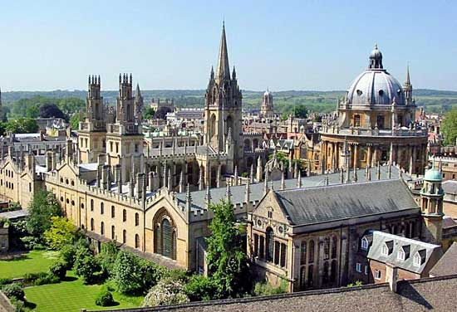
Background to the poet
Stephen Spender (1909-1995) mixed with a number of left wing poets while at Oxford, including W. H. Auden, and joined the fight against Franco in the Spanish Civil War. Always interested in human and social concerns, he questioned how poetry could address such issues.
Conduct your own research about Spender’s biography or work and search for information to enlighten you about the poet and the poem.

Slide 4
My Parents
My parents kept me from children who were rough
Who threw words like stones and wore torn clothes
Their thighs showed through rags. They ran in the street
And climbed cliffs and stripped by the country streams.
I feared more than tigers their muscles like iron
Their jerking hands and their knees tight on my arms
I feared the salt coarse pointing of those boys
Who copied my lisp behind me on the road.
They were lithe, they sprang out behind hedges
Like dogs to bark at my world. They threw mud
While I looked the other way, pretending to smile.
I longed to forgive them but they never smiled.

Slide 5
Summarise the meaning
Ostensibly, this is a poem about a boy being bullied and about the victim’s response to the other boys.
What is [literally] happening in each stanza?
1.
2.
3.
Now, what might these ideas represent otherwise? Read between the lines and beyond the text, how do these ideas relate to life?
Some versions of the poem have ‘tripping’ in the last line of the first stanza instead of ‘stripping’. What would be the difference between the two? Which do you think suits the poem best?

Slide 6
The SIFT method to analyse and revise poems.
Specify the subject matter and sense of the poem through a brief summary
Inform us of the intention of the poet and his/her main ideas overall
Focus on the form ( structure/punctuation) and the feelings conveyed ( poet’s attitude/tone used) and how this highlights the main ideas
Tell us about the techniques, imagery and poetic language that show the ways ideas are presented

Slide 7
Close Reading Questions
Explain why the last 2 lines of the poem are important.
Why did the poets use of alliteration show the bullies as lower class kids.
Why does the poet use “more than tigers”?
How does the poet compare and contrast differences between social classes.
What relevance does the title have to the poem?
What is the effect of the final line of the reader?
What is the effect of the use of the tightly structured stanzas?
Identify the poet’s view on his parents?
What if the poem followed a rhyme scheme?
What if the narrator was part of the lower class?
Provide evidence for every answer!

Slide 8
Analysis of the poem
The poem ‘My Parents’ touches on a social divide between the comfortable middle class narrator and local working class children. It is a divide of which both sides are keenly aware. On the one side, the narrator’s ‘parents kept me from children who were rough’, while on the other, the children ‘threw mud’ ‘at my world’. What is Spender suggesting about the co-existence of these two ‘worlds’?
At the end of the poem, the narrator and the other children remain apart: ‘I longed to forgive them but they never smiled.’ As the poem develops through its three stanzas, the boy seems to long for more than to offer forgiveness. Spender’s language consistently expresses admiration, even envy, of the other children. Though they are poor, with ‘torn clothes’, they have a vitality that he self-consciously lacks with his ‘lisp’. Note that the verbs applied to them are full of action – ‘threw’, ‘ran’, ‘climbed’, ‘tripped’, ‘sprang’ – while the narrator’s verbs are passive and weak – ‘feared’, ‘looked’, ‘pretending’, ‘longed’. The vigour of the children’s actions is emphasised by their rhythmic placing in the lines.

Slide 9
Analysis of the poem
The local children have freedom, roaming ‘the street’, ‘cliffs’ and ‘country streams’ and they have physical presence, with ‘thighs’, ‘muscles like iron’ and they are described as ‘lithe’. The reminiscence of childhood shows a community divided by class and education, but also contains a yearning for something missed.
The title is interesting. The parents are not mentioned after the first words of the poem, so what effect and significance does the choice of title have?

Slide 10
Compare with
Childhood Frances Cornford
For Heidi With Blue Hair Fleur Adcock
Praise Song for My Mother Grace Nichols
Follower Seamus Heaney
Country School Allen Curnow
Further reading
http://www.poetryarchive.org/poetryarchive/singlePoet.do?poetId=7522

