Slide 1

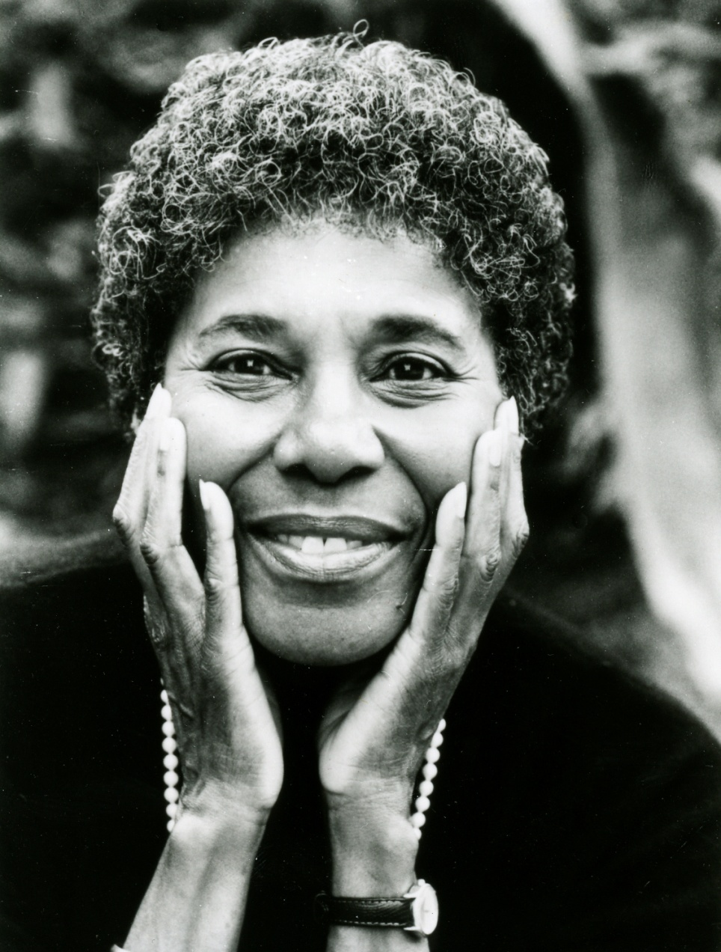
To Da-duh, In Memoriam
(1985)
Paule Marshall

Slide 2
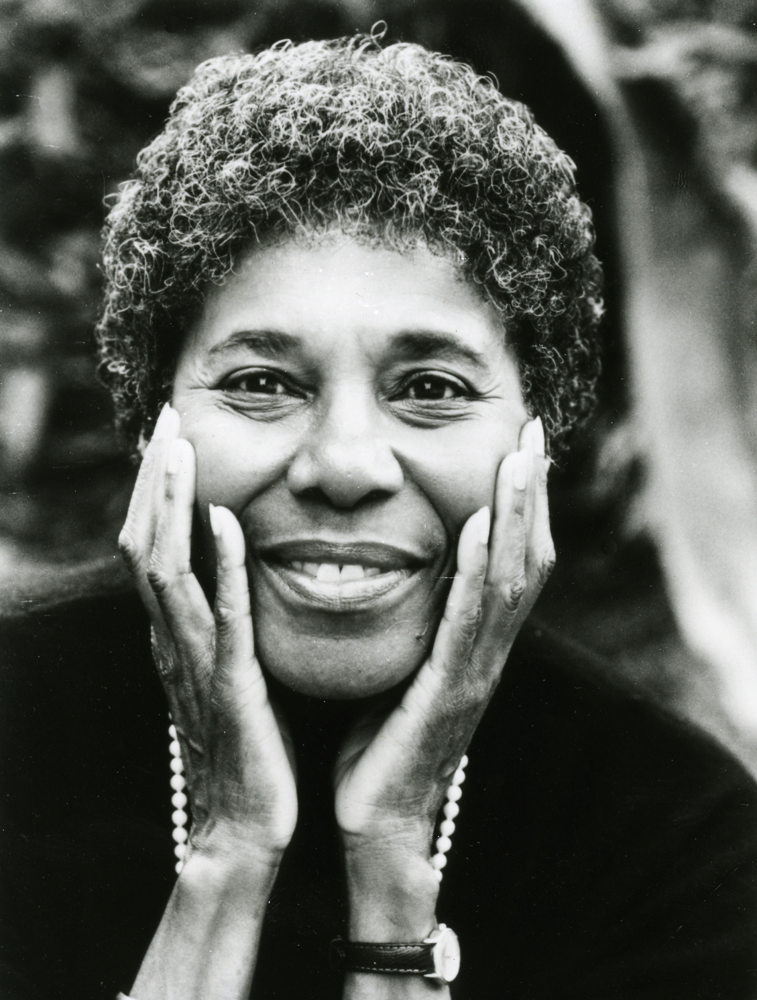
Biography
From Wikipedia
Paule Marshall (born April 9, 1929) is an American author. She was born Valenza Pauline Burke in Brooklyn to Barbadian parents and educated at Brooklyn College (1953) and Hunter College (1955). Early in her career, she wrote poetry, but later returned to prose.
Marshall has taught at Virginia Commonwealth University and Berkeley in California, the Iowa Writer’s Workshop, and Yale University before holding the Helen Gould Sheppard Chair of Literature and Culture at New York University. She lives in Richmond, Virginia
She is a MacArthur Fellow and is a past winner of the Dos Passos Prize for Literature. She was designated as a Literary Lion by the New York Public Library in 1994.
"I realise that it is fashionable now to dismiss the traditional novel as something of an anachronism, but to me it is still a vital form. Not only does it allow for the kind of full-blown, richly detailed writing that I love… but it permits me to operate on many levels and to explore both the inner state of my characters as well as the worlds beyond them.”

Slide 3
Vocabulary
In pairs, scan odd / even pages of the story for interesting vocabulary. Make a list to share at the end.
Now, create a mix and match activity to test another pair in the class with. Make the vocabulary you choose challenging to them.

Slide 4
Overview
The narrator in this story remembers her visit from New York to her mother’s home country, which to her is the ‘alien sight and sounds of Barbados’.
The story hinges on the relationship formed between the young girl and her grandmother, Da-duh of the title. While the Caribbean is unfamiliar to the young girl, who sees it as ‘some dangerous place’, Da-duh wants to show off its qualities, and a competition is established between the girl and the grandmother, between youth and age, between modernity and tradition and between New York and Barbados, which culminates in the girl’s assertion of the height of the Empire State Building, which dwarfs all that Da-duh shows her.
The young girl’s triumph, however, is tempered at the end of the story by ‘the shadow’ of Da-duh’s death.

Slide 5
Plot
What actually happens in the story? List the events in order.
What is interesting or surprising about what happens?

Slide 6
Read and comment on…
1 How old is the narrator when making the trip from New York to Barbados? When is the story set?
2 What impression do we first get of Da-Duh? p342/343 Do the inclusions of light and darkness have some bearing on Da-Duh and on the narrator?
3 What more do we get to know about Da-Duh’s status among her own people…see p344
4 Describe the narrator’s impressions of Barbados from the start of the story through to the end of p344.
5 p345 onwards becomes a competition of pride in one’s place and quite a bit is revealed about the two characters. Explain what you get to know about the characters and their changes in mood.
6 By the end of the story there is a final act of defiance by Da-Duh against the British air force. She has roused herself from life’s defeat to be challenging one last time and to be proud of her own place. The narrator, at the end of the story which is now years later, seems to pursue a life which has some echoes of Da-Duh’s life. Explain this a bit further.

Slide 7
Point of View
‘‘To Da-duh, in Memoriam’’ is written from the first-person point of view. The majority of the story is viewed through the child narrator’s eyes. She recalls when she first met Da-duh, her first impression of the sugar cane fields, and the rivalry that exists between the two family members. Hers is the only voice the reader hears, and hers are the only eyes through which the reader sees Barbados and Da-duh. Thus the rivalry—and both participants’ reaction to it—is only explained as a nine-year-old child might have seen, or an adult looking back...

Slide 8

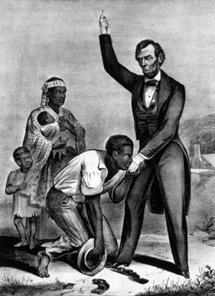

Themes
Rivalry
Time
Rural and Urban worlds
Slavery and Colonisation

Slide 9
Analyse a theme
Questions to ask about themes.
What evidence is in the story of this theme?
How is the theme presented to readers?
What is the writer trying to say about this theme? What messages does she imply?
Why does the writer explore this theme? For what purpose?

Slide 10
Rivalry
The story pits an aging Barbadian grandmother against her youthful American granddaughter. Upon their first meeting, the two sense a similarity in each other that far outweighs the differences presented by the seventy years between them. Most importantly, each has a stubborn strength of will and a confidence that her way of regarding the world is the right way.
The characters knowingly participate in this rivalry. Da-duh has the knowledge that comes with age and experience, but the narrator has the brash confidence of youth. Da-duh has her pride of place, showing off her land with its lush plants, trees, and cane fields. The narrator has the technological superiority of the modern world, which she uses to goad her grandmother into silent submission; Da-duh is not impressed by technology, but it is so foreign to her that she cannot even conceive of her granddaughter’s descriptions of life in New York. The story ends with the narrator’s victory in this rivalry, which makes her feel somewhat sad because she knows that her success only comes as a result of her grandmother’s concession.

Slide 11
Time
As the oldest and youngest characters presented in the story, Da-duh and the narrator represent the span of time and its cyclical nature. Marshall writes in the last paragraph, ‘‘She died and I lived’’; in a sense, the role that Da-duh occupied in the family has passed on to the narrator. She dies to make way for her granddaughter and the world, period, and change that she symbolizes.
The grandmother and granddaughter also represent how the passing of time changes the world, forcing its older members to be left behind. The granddaughter’s triumph at the end of her visit illustrates that in many ways the world truly belongs to the new generation. This theme is further reinforced by Da-duh’s death soon thereafter. There is no place for Da-duh in the modern world, therefore she must leave.

Slide 12
Rural and Urban Worlds
Because of their stubbornness, grandmother and granddaughter participate in a rivalry in which each tries to prove that her world is superior. Daduh has the wonder and beauty of the natural world on her side, but her granddaughter has all the technological wonders of the urban world. Da-duh is frightened of the trappings of the modern world; in the truck, driving through Bridgetown, she clutches the narrator’s hand tightly. Once back in the country, among the sugar cane fields, she feels safe and comfortable again. The granddaughter, a child of one of the most vibrant cities in the world, is unimpressed by these sights, however. To her, the sugar canes—which have sustained the Barbadian economy for hundreds of years—are only giant weeds.
Da-duh and the narrator spend most of their days together walking around the land. Da-duh points out all the amazing sites of the island—the fruit-bearing trees and plants, the tropical woods, the tall royal palm. Each of these objects that are so precious to Da-duh come from the natural, rural world and represent the agricultural tradition of Barbados. In response to Da-duh, the narrator shows off the dances she learns from the movies and the songs that play on the radio. She brags about all the machines and technology New York offers—kitchen appliances, trolleys and subways, electricity—technology of the urban, modern world. She finally wins the rivalry by telling Da-duh about the Empire State building, which was the tallest building in the world at that time and hailed as a great wonder of architecture.

Slide 13
Slavery & Colonisation
Barbados was a British colony for hundreds of years. Historically, the lands of Barbados belonged to the privileged white minority, while enslaved Africans worked the land that made them wealthy. Emancipation came to Barbados in 1838, but the whites still held the power. Conditions for Africans on the island essentially remained the same.
Many elements in ‘‘To Da-duh, in Memoriam’’ reflect this heritage. As Martin Japtok writes in African American Review, in this story ‘‘Marshall shows the inescapability of history by inscribing it into the very landscape.’’ The plants that Da-duh so proudly shows off to her granddaughter, whose names Da-duh intones ‘‘as they were those of her gods,’’ are not indigenous to the island, instead originating from other British colonies. Indeed, sugar cane, which brings Da-duh so much happiness, was the fundamental cause of long-lasting African exploitation. The planes that bring about Da-duh’s death also represent colonial oppression; Britain ordered these flyovers in response to a 1937 strike and riot.

Slide 14

Themes in ‘Journey’
Class brainstorm a set of themes which are presented in Grace’s story [think-pair-share]
Groups select 4 KEY themes – that are central to the story, and rank from 1 to 4 in order of importance.
Provide a justification for those 4 themes being central and ranked in that order.
Class are to agree on the top 4.

Slide 15
Journey & To Da-Duh
What aspects of the stories shall we compare?
What aspects of the stories shall we contrast?
SIMILARITIES | DIFFERENCES
1. | 1.
2. | 2.
3. | 3.
4. | 4.
5. | 5.
6. | 6.
INTERESTING - - -
Include a point about narrative methods.

Slide 16
Essay topics
Key words are highlighted
Discuss how two writers use different narrative methods to explore similar themes in two stories from your selection.
Discuss how two authors comment on the conflicts between tradition and modernity in two stories from your selection.
Discuss ways that two stories explore nature.
Firstly, turn each essay topic into a question, using the key words of the topic. Questions help us to understand what the topic is implying and what the examiners REALLY want us to write about.
They also give us a clearer path to brainstorm.

Slide 17
Character – Da-duh
Da-duh is the narrator’s eighty-year-old grandmother. She has lived her whole life on Barbados and is confident and proud of her lifestyle, surroundings, and ways of looking at the world. She dislikes the trappings of the modern world, such as any form of machinery, and is uncomfortable in the city of Bridgetown. When Da-duh first meets the narrator, the narrator imagines that she saw ‘‘something in me which for some reason she found disturbing.’’ However, Da-duh also feels connected to her granddaughter, as evidenced when she clasps her hand.
Da-duh is completely at home in the countryside of St. Thomas where she lives. She takes her granddaughter on daily walks on the land surrounding her house. She shows off the glories of the natural world, and listens with an air of fear to her granddaughter’s descriptions of life in New York. She is not accustomed to having her life challenged, as her granddaughter does, and she attempts to assert authority through the royal palm tree, which is the tallest thing she has ever seen. When her granddaughter tells her about the Empire State building, Da-duh is finally defeated.
The small instances of surrender that the narrator had seen throughout the visit now pervades Daduh’s person. Instead of eagerly going on walks, she spends mornings staring out the window and spends her afternoons napping; grandmother and granddaughter take only brief, dispirited walks.
She dies shortly after her family leaves, and her death suggests both her stubbornness and her defeat. When Britain sends planes to fly low over the island in retaliations for riots and strikes, Da-duh, alone among her community, refuses to take cover in the cane fields. She stays in the house and watches the planes. The narrator imagines that it must have seemed to Da-duh that the planes were going to destroy her house and the whole island. When the rest of the village returns to their homes after the planes have departed, Da-duh is dead, still sitting in her chair at the window.

Slide 18
Character - Narrator
Narrator
The narrator is nine years old when she visits Barbados and meets her grandmother, Da-duh, for the first time. The narrator is a strong-willed, unique child. Her stubbornness matches Da-duh’s, and both of them immediately recognize this similarity. Sensing this, the two lock gazes upon first meeting, and the narrator revels in her triumph when her grandmother looks away first.
Their likeness draws them together. On the day after their arrival, the pattern of their relationship emerges when Da-duh takes her granddaughter on a walk through the countryside. Da-duh shows off her world, and when prodded by her grandmother, the narrator agrees that they have no natural, healthy environments like this in Brooklyn. Da-duh’s comments make the girl realize what her world is missing. At the same time, however, the natural world discomfits the girl. She sees the sugar canes as ‘‘giant weeds’’ and thinks they have taken over the island. The narrator brings into her grandmother’s world songs, dances, ideas, and descriptions of the city, which her grandmother listens to, with a sense of disbelief. Throughout the course of the visit, grandmother and granddaughter battle over whose world is more grand.
Toward the end of the trip, however, the narrator wins the battle with finality when she tells Daduh about the Empire State building, which would tower over the royal palm tree, the tallest thing that Da-duh has ever seen. However, the narrator is able to take little delight in her victory. For the rest of the trip, she tries to perk her grandmother up by performing songs.
After leaving the island, the narrator never sees her grandmother again because Da-duh dies soon thereafter. The memory of Da-duh, and the way she belittled her, remains with the narrator for the rest of her life. She also learns a valuable lesson from her grandmother: that in its unique way, the rural, natural world is as important as the urban, technological world and has something of value to offer her.

Slide 19
Critical Overview
‘‘To Da-duh, in Memoriam’’ was originally published in 1967. Although it drew the attention of a few early literary scholars, at that time Marshall had a relatively small audience. Lloyd W. Brown wrote in a 1974 article for Novel: A Forum on Fiction that such neglect is ‘‘unfortunate, because Paule Marshall’s major themes are both significant and timely’’ and help to define the contemporary African American identity. In 1983, ‘‘To Da-duh, in Memoriam’’ was reissued and published in Marshall’s collection Reena, and Other Stories.

Slide 20
SUMMARY
The narrator in this story remembers her visit from New York to her mother’s home country, which to her is the ‘alien sight and sounds of Barbados’. The story hinges on the relationship formed between the young girl and her grandmother, Da-duh of the title. While the Caribbean is unfamiliar to the young girl, who sees it as ‘some dangerous place’, Da-duh wants to show off its qualities, and a competition is established between the girl and the grandmother, between youth and age, between modernity and tradition and between New York and Barbados, which culminates in the girl’s assertion of the height of the Empire State Building, which dwarfs all that Da-duh shows her. The young girl’s triumph, however, is tempered at the end of the story by ‘the shadow’ of Da-duh’s death.

Slide 21
EXTENSION
Wider reading
This story is taken from Merle and Other Stories by Paule Marshall.
Compare with
Journey by Patricia Grace
Online
Information about Paule Marshall is available at:
http://www.answers.com/topic/paule_marshall

Slide 22
Compare with Journey
Construct an essay PLAN only to this topic:
“Discuss the narrator’s character in Journey. To what extent do you sympathise with his attitude to the land?”

